Slide 1
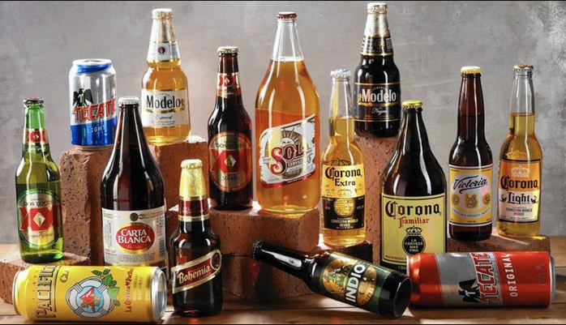
Beer Recommendation System
Zixiang Wen
Department of Plant, Soil and Microbial Sciences
Michigan State University
Notes:
I am glad to be here to talk about what we have done during last year.

Slide 2
1. Introduction
Objective:
Build a recommendation system to leverage users historical ratings to create predictions for un-tasted beers and create a personalized recommendation for which beer to sample next.
Target audience:
Beer enthusiast
Breweries operating in the US

Slide 3
1.1 Data source information
Download address:
https://www.kaggle.com/rdoume/beerreviews
Table 1 Features information from beer reviews dataset
Feature name | Count | Missing | Type | Note
brewery_id | 1586614 | 0 | int64 | An identifier for the brewery
brewery_name | 1586599 | 15 | object | The name of brewery
review_time | 1586614 | 0 | int64 | when the review was submitted
review_overall | 1586614 | 0 | float64 | Rating of the beer overall (1.0 to 5.0)
review_aroma | 1586614 | 0 | float64 | Rating of the beer's aroma (1.0 to 5.0)
review_appearance | 1586614 | 0 | float64 | Rating of the beer's appearance (1.0 to 5.0)
Re_profilename | 1586266 | 348 | object | The profile name of the reviewers
beer_style | 1586614 | 0 | object | The style of beer
review_palate | 1586614 | 0 | float64 | Rating of the beer's palate (1.0 to 5.0)
review_taste | 1586614 | 0 | float64 | Rating of the beer's taste (1.0 to 5.0)
beer_name | 1586614 | 0 | object | Name of the beer
beer_abv | 1518829 | 67785 | float64 | The alcohol by volume of the beer
beer_beerid | 1586614 | 0 | int64 | A unique ID indicating the beer reviewed

Slide 4
1.2 Data cleaning
Table 2 Main cleaning steps for the dataset
Feature name | Cleaning steps
brewery_name | Drop missing value. Keep name started with letter or number (a-zA-Z0-9)
review_time | Convert to YYYY-MM-DD format
review_profilename | Fill ‘nan’ with ‘Unknown’
beer_abv | Drop missing value
beer_beerid | Count the number of id. Discard the id with review count <5
5 review indexes* | Discard the review small than 1 and larger than 5

Slide 5
2. Data Exploration
2.1 Describe statistics
Table 3 Describe statistics of the 5 review indexes and alcohol content for beers
 | review _overall | review _aroma | review _appearance | review _palate | review _taste | beer_abv (%)
Count | 19209 | 19209 | 19209 | 19209 | 19209 | 19209
Mean | 3.71 | 3.62 | 3.74 | 3.63 | 3.66 | 6.58
Std | 0.45 | 0.48 | 0.38 | 0.44 | 0.50 | 2.18
Min | 1.14 | 1.17 | 1.50 | 1.23 | 1.15 | 0.05
25% | 3.50 | 3.40 | 3.57 | 3.42 | 3.42 | 5.00
50% | 3.79 | 3.69 | 3.81 | 3.70 | 3.75 | 6.00
75% | 4.00 | 3.94 | 4.00 | 3.92 | 4.00 | 7.80
Max | 4.94 | 5.00 | 4.93 | 4.94 | 4.94 | 41.00
Describe statics showed that there are no big variations existing in features probably due to fixed rating range from 1 to 5. For instance, the overall review(review_overall) varies from 1.14 to 4.9 with a mean of 3.71. However, we observed large variation for the alcohol content (beer_abv), which varies from 0.05% to 41% with a mean of 6.58%.

Slide 6
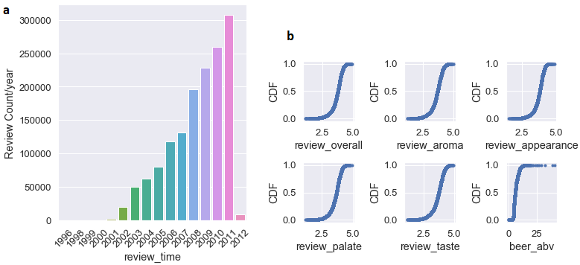
Figure 1 Review time (a) distribution and review indexes (b) cumulative distribution

Slide 7
2.2 Ranking and sorting beer brand, style and brewery
Table 4 Top ten the most popular beer brand
Rank | Beer Name | Review average
1 | Alesmith Speedway Stout - Vanilla And Coconut | 4.887500
2 | El Gordo | 4.828571
3 | M Belgian-Style Barleywine | 4.735714
4 | Capricho Oscuro - Batch 1 | 4.716667
5 | Coffee Infused Imperial Stout Trooper | 4.700000
6 | Cantillon La Dernière Cuvée Du 89 | 4.683333
7 | Barrel Aged Stout | 4.680000
8 | Armand'4 Oude Geuze Lente (Spring) | 4.673846
9 | Kopi Con Leche Stout | 4.671429
10 | Hitchhiker | 4.666667
The number 1 of most popular beer is Alesmith Speedway Stout - Vanilla And Coconut. This brand of beer has chocolate and roasted malts dominate the flavor, supported by notes of dark fruit, toffee, and caramel

Slide 8
Table 5 Top ten the most popular beer style
Rank | Beer style | Review AVG*
1 | Quadrupel (Quad) | 4.135505
2 | American Double / Imperial Stout | 4.131664
3 | Russian Imperial Stout | 4.113477
4 | American Wild Ale | 4.097805
5 | Eisbock | 4.088967
6 | Gueuze | 4.084845
7 | American Double / Imperial IPA | 4.061975
8 | Lambic - Unblended | 4.038159
9 | Weizenbock | 4.034948
10 | Flanders Red Ale | 4.026596
The most popular beer style is Quadrupel (Quad). Inspired by the Trappist brewers of Belgium, the Quadrupel is a Belgian-style ale of great strength with even bolder flavor compared to its sister styles Dubbel and Tripel.

Slide 9
Table 6 Top ten highly rated brewery
Rank | Brewery Name | Brewery ID | Review AVG
1 | Brouwerij Westvleteren | 313 | 4.51
2 | Närke Kulturbryggeri AB | 10902 | 4.48
3 | The Alchemist | 27039 | 4.47
4 | Micro Cervejaria Falke Bier | 10287 | 4.47
5 | Old Chimneys Brewery | 6560 | 4.43
6 | Benny Brewing Company | 24757 | 4.42
7 | Kane Brewing Company | 26676 | 4.41
8 | Denison's Brewing Company & Restaurant | 662 | 4.40
9 | Breakwater Brewing | 17988 | 4.38
10 | Brauerei Zehendner GmbH | 5983 | 4.38

Slide 10
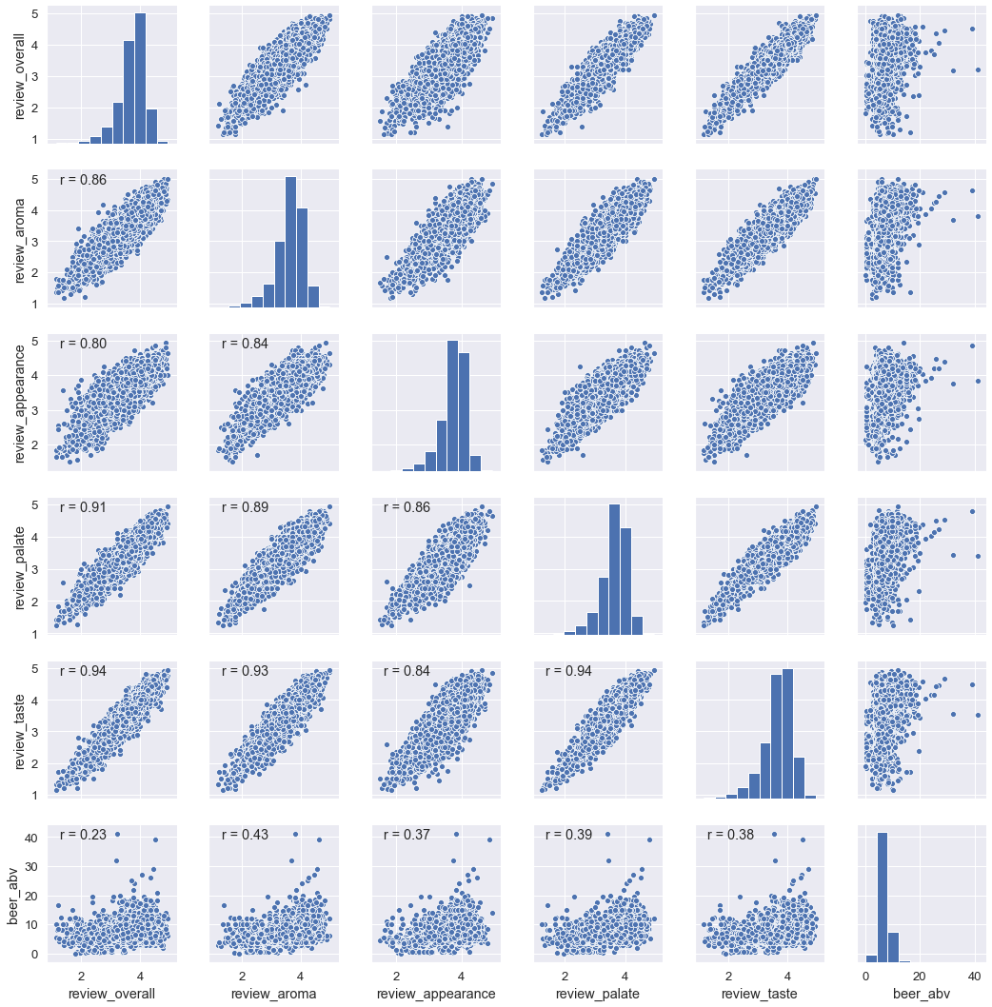
2.2 Relationship among the features
Figure 2 Histogram and scatter plot showing the relationships among the features.

Slide 11
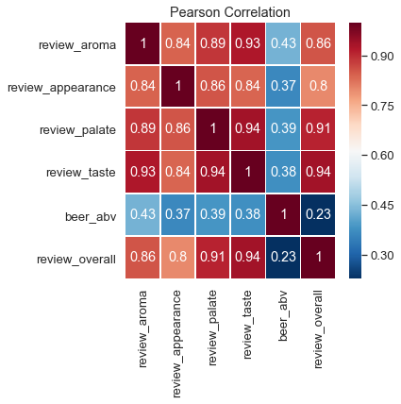
Figure 3 Correlation coefficient among 5 review indexes and alcohol content
The correlation coefficient between alcohol content and the 5 review indexes is relatively low with range of 0.23 to 0.43. The results suggest that alcohol content dose not play important role for beer rating. The histogram of the 5 review indexes (Fig. 2) showed that rating score slightly skewed to right side indicated that there are more people like the beer they rated than who did not.

